Slide 1
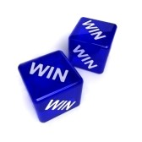
Creating win-win situation
What is the meaning of a win-win situation?
Here is a description of what I am speaking of:

Slide 2
Definition of win win situation
A situation where both parties gain from a transaction or deal, or where all possible outcomes are favourable.
.
Example of a win win situation
Hiring summer interns from the university continues to be a with students gaining valuable real world experience and businesses receiving the benefit of employees with cutting edge technical skills

Slide 3
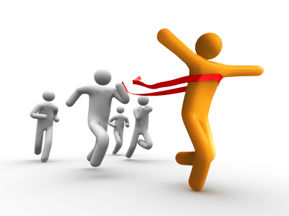

What happens in a win win situation when someone has to win?
Nobody has answered this cuz its a crazy question but A win-win is a situation by which cooperation, compromise, or group participation leads to all participants benefiting.

Slide 4
Some characteristics of win win situation
There are no losers (everyone enjoys the accomplished task).
All are involved (no-one is left out or sits out).
The situation is psychologically working on many levels (communication, supporting each other, having fun in a group ).

Slide 5

The Importance of a Win-Win Situation
When you’re buying a house, you’re looking to get the lowest price possible. When you’re selling a house, you try to sell it for as much as possible. With these conflicting motives, no wonder real estate deals fall through as much as they do. So how can this be solved? By approaching a real estate transaction with a “win-win” attitude in mind.

Slide 6

How to create a win win situation
Compromise and understanding
Agree to act in both their own interest
Cooperation must be more
Least as important as ego and competition.

Slide 7
Discussing the issue
Listening to others
Taking time out
Explaining one’s own perspective and needs
Compromising

Slide 8
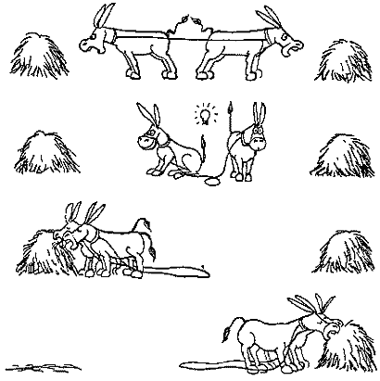

Slide 9
The Win/Win Approach
Some of the main messages and intentions behind Fight behaviors are:
I’m right / you’re wrong
To blame or punish
To threaten
I’m OK / you’re not

Slide 10

Compromise is sometimes considered the same as a Win/Win approach. Some of the reasons that we so often use it are:
Simplest, easiest and fairest thing to do.
It means that when we can’t make a bigger pie, at least everyone is sharing what is available.

Slide 11


